Slide 1


Visali Devi Nerla
14 April 2025

Slide 2

Outline
Executive Summary
Introduction
Methodology
Results
Conclusion
Appendix

Slide 3
Executive Summary
Methodologies Used:
Collecting the Data
Data Wrangling
Exploratory Data Analysis (EDA)
Using SQL
Using Pandas and Matplotlib
Interactive Visual Analysis
Using Folium
Using Plotly Dash
Predictive Analysis
Results Provided:
Exploratory Data Analysis
Geospatial Analysis
Interactive Dashboard
Predictive Analysis

Slide 4
Introduction
Spaces X’s Falcon 9 launch regular rockets. This launch has two stages.
The first stage is responsible for providing the initial thrust to lift the rocket off the ground and propel it into space.
Once the first stage has burned through its fuel, it separates from the second stage and begins its descent back to Earth for landing.
Space Y is a new player in commercial rocket launch market and is trying to mimic Space X’s formula
Space Y wants to use machine learning techniques to predict success rate of Falcon 9 in different stages and leverage the findings to make informed decision for their own projects
Data Scientists at Space Y wants to develop a model to accurately predict the success rate of first stage landing of Space X’s Flacon 9

Slide 5

Section 1

Slide 6
Methodology
Executive Summary
Data collection methodology:
Using SpaceX’s REST APIs and with Web Scraping
Perform data wrangling
Raw data needs to be cleaned, and transformed to suit the analysis requirements. This involves removing duplicates, updating missing values, and standardizing formats
Perform exploratory data analysis (EDA) using visualization and SQL
Perform interactive visual analytics using Folium and Plotly Dash
Perform predictive analysis using classification models
Access the accuracy of each classification model to determine best one

Slide 7
Data Collection
Data collection process through API requests from Space X REST API
GithubLink_to_DataCollectionAPI
Data collection using web scraping the data from a table in Space X’s Wikipedia page
GitHubLink_to_WebScraping
SpaceX REST API (api.spacexdata.com/v4/launches/past to obtain past launch data)
A JSON response from the API containing a list of JSON objects
Convert the JSON data into a flat table (json_normalize)
Filter data to only include Falcon 9 launches
Data cleaning – remove null values, update missing values with mean
SpaceX Wikipedia page (List of Falcon 9 and Falcon Heavy launches – Wikipedia)
BeautifulSoup object from HTML response and find all tables
Find launch info html table and use column names as keys in a dictionary
Iterate through table cells to extract data to dictionary
Convert the dictionary to a Pandas DataFrame

Slide 8
Data Collection – SpaceX API
SpaceX REST API (api.spacexdata.com/v4/launches/past to obtain past launch data)
Receive a JSON response from the API containing a list of JSON objects
Convert the JSON data into a flat table (json_normalize)
Filter data to only include Falcon 9 launches
Data cleaning – remove null values, update missing values with mean
Data Source:
SpaceX REST API (api.spacexdata.com/v4/launches/past to obtain past launch data)
GET Request and Response:
Make GET request to the API and convert the response to .json that contains a list of JSON objects
Data Transformation:
Convert .json file to a pandas DataFrame
Define lists to store data and store this as dictionary
Filter data to only include Falcon 9 lauches
Replace missing values of PayLoadMass with the mean PayLoadMass value
GithubLink_to_DataCollectionAPI

Slide 9
Data Collection – Web Scraping
SpaceX Wikipedia page (List of Falcon 9 and Falcon Heavy launches – Wikipedia)
BeautifulSoup object from HTML response and find all tables
Find launch info html table and use column names as keys in a dictionary
Iterate through table cells to extract data to dictionary
Convert the dictionary to a Pandas DataFrame
Data Source:
SpaceX Wikipedia page (List of Falcon 9 and Falcon Heavy launches – Wikipedia)
Web Scraping:
Utilizing the Python BeautifulSoup package to extract data from HTML tables
Data Parsing and Conversion:
Collect all column names from the tables found within the HTML page
Use column names as keys in a dictionary
Use custom functions and logic to parse all launch tables to fill the dictionary values
Convert the dictionary to a Pandas DataFrame
GitHubLink_to_WebScraping

Slide 10
Data Wrangling
Main outcome of the data wrangling is to convert the outcomes into Training Labels - with 1 means the booster successfully landed, 0 means it was unsuccessful
True ASDS, True RTLS, & True Ocean are set to 1
None None, False ASDS, None ASDS, False Ocean, False RTLS are set to 0
Process involved:
Load Space X dataset (data collected from API and web scraping)
Calculate the percentage of the missing values in each attribute
Identify which columns are numerical and categorical
Create a landing outcome label from Outcome column
Calculate various metrics to access the performance of Falcon 9 at each orbit - number of launches on each site, number and occurrence of mission outcome of the orbits, number and occurrence of each orbit
GitHubLink_to_DataWrangling

Slide 11
EDA with Data Visualization
In this phase, the data is further analyzed to predict if the Falcon 9 first stage will land successfully
This is important as the cost savings (compared to other competitors come from the fact that SpaceX can reuse the first stage
Process involved:
Read the SpaceX dataset into a Pandas dataframe
Plot various scatter, line, and bar charts to understand the relationship between various variables
Plots include
Scatter plots - Flight Number vs. Payload Mass, Flight Number vs. Launch Site, Payload Mass vs. Launch Site, Flight Number vs. Orbit, Payload vs Orbit
Bar chart - Orbit vs. Success Rate
Line chart - Success Yearly Trend
GitHubLink_to_EDAwithVisualization

Slide 12
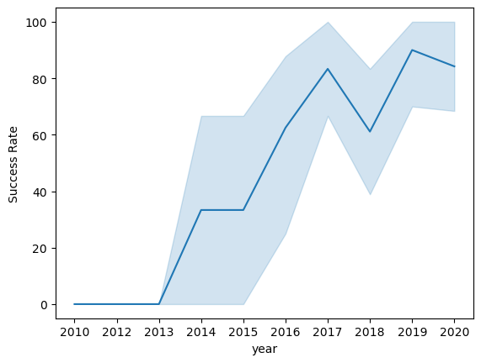
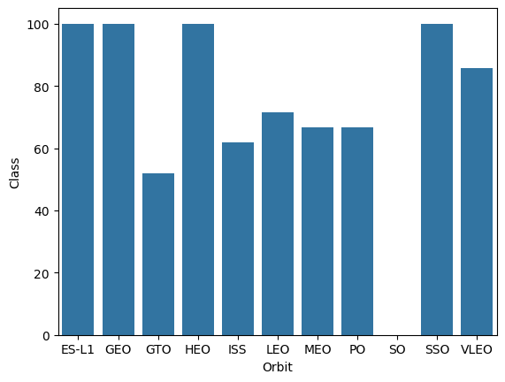
EDA with Data Visualization – contd.
Launch success yearly trend
Important outcomes:
VAFB-SLC launchsite has no rockets launched for heavy payload mass (greater than 10000)
ES-L1, GEO, HEO, SSO orbits have highest success rates
LEO orbit success seems to be related to the number of flights. Conversely, in the GTO orbit, there appears to be no relationship between flight number and success
With heavy payloads the successful landing or positive landing rate are more for Polar, LEO and ISS. For GTO, it's difficult to distinguish between successful and unsuccessful landings as both outcomes are present
The success rate of the launches constantly increasing since 2013 till 2020
Success rate of each orbit type

Slide 13
EDA with SQL
This is to further understand the Spacex DataSet by loading the dataset into the corresponding table in a Db2 database and querying the data to get answers to the questions related to dataset
Process involved:
Load the dataset into the corresponding table in a Db2 database
Query the db tables to perform below tasks
Remove blank rows from table
Display the names of the unique launch sites in the space mission
Display average payload mass carried by booster version F9 v1.1
Display the total payload mass carried by boosters launched by NASA (CRS)
List the date when the first successful landing outcome in ground pad was achieved
List the total number of successful and failure mission outcomes
GitHubLink_to_EDAwithSQL

Slide 14
Build an Interactive Map with Folium
Purpose of this step is to do the following tasks:
TASK 1: Mark all launch sites on a map
TASK 2: Mark the success/failed launches for each site on the map
TASK 3: Calculate the distances between a launch site to its proximities
Folium Map object has to be initialized and folium.Circle and folium.Marker has been added for each site
Marker color to be assigned to success (1) as green and failure (0) as red
Create an icon as text label, assigning the icon_color as the marker_color
Using lat and long values calculate the distance between points
folium.polyline can be used to display the distance line between two points
GitHubLink_to_InteractiveDataAnalyticsUsingFolium

Slide 15
Build a Dashboard with Plotly Dash
Main purpose of a Dashboard with Plotly Dash includes to answer the following questions:
Which site has the largest successful launches?
Which site has the highest launch success rate?
Which payload range(s) has the highest launch success rate?
Which payload range(s) has the lowest launch success rate?
Which F9 Booster version (v1.0, v1.1, FT, B4, B5, etc.) has the highest launch success rate?
Process involved:
Building a pie chart to show all sites and individual sites upon filtering vs. their success rates – use px.pie(), dcc.dropdown() object
Building a scatter graph to show the correlation between outcome (success vs. unsuccess) and payload mass (kg) – use px.scatter(), RangeSlider() object
GitHubLink_to_InteractiveDashboardwithPlotly

Slide 16
Predictive Analysis (Classification)
Objective of this analysis is to find the best Hyperparameter for SVM, Classification Trees and Logistic Regression and find the method performs best using test data
Process involved:
Create a column for the class: Create a NumPy array from the column Class in data
Standardize the data: Standardize the data using StandardScalar() and fit_transform() methods and reassign it to the dataframe
Split into training data and test data: Use a 20% of the data for testing and remaining for training the model. Create a logistic regression, support vector machine, decision tree classifier, and KNN objects and fit these objects to find best parameters.
Identify the best method with high accuracy: Calculate the accuracy and scores of each of these methods to identify best methods.
GitHubLink_to_MachineLearningPredictionAnalysis

Slide 17
Results
Exploratory data analysis results
Interactive analytics demo in screenshots
Predictive analysis results

Slide 18

Section 2

Slide 19
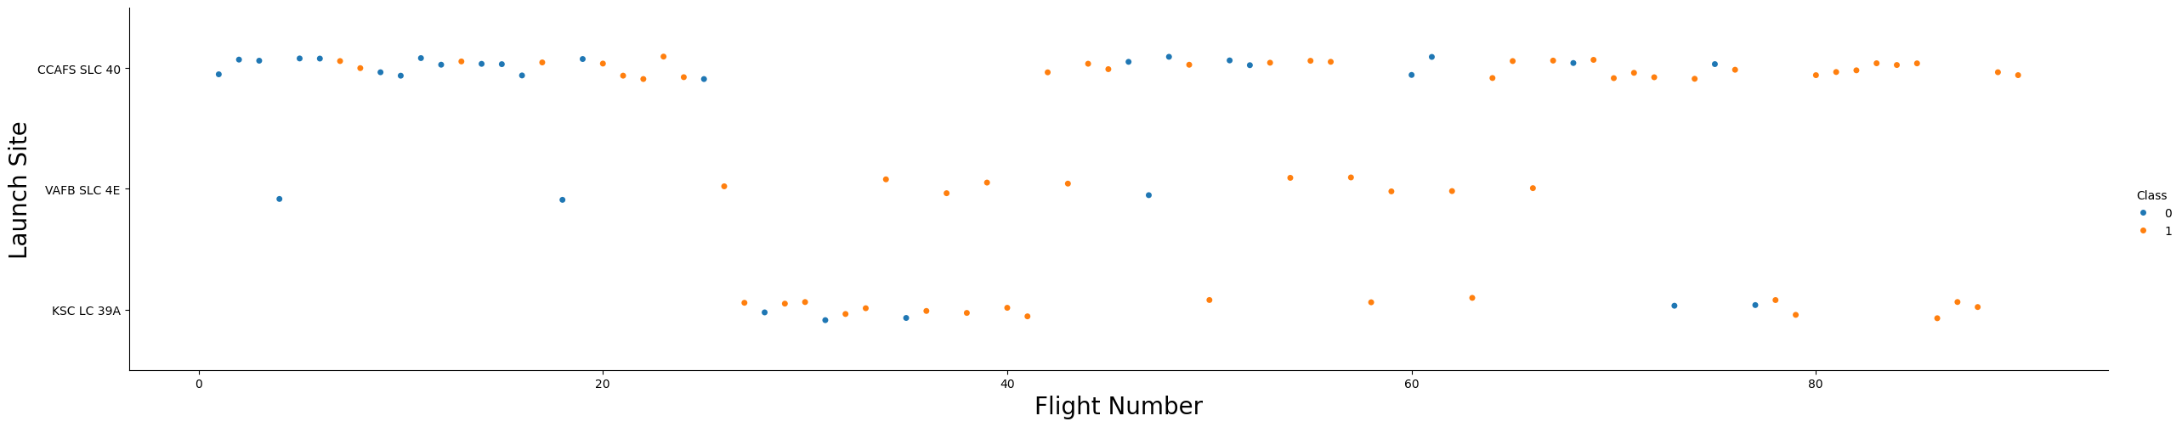
Flight Number vs. Launch Site
Orange dots indicate successful launch, and blue dots indicate unsuccessful launch
As the number of flights increase, the successful launches increase as well
Above 40, the successful launches increased significantly

Slide 20
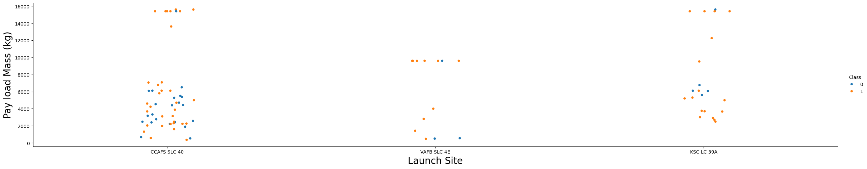
Payload vs. Launch Site
Orange dots indicate successful launch, and blue dots indicate unsuccessful launch
Unsuccessful events are relatively less above 6,000 kg payload
All the sites launched high and low payloads. CCAPS SLC 40 launched relatively smaller payloads

Slide 21
Success Rate vs. Orbit Type
ES-L1, GEO, HEO, and SSO orbits have 100% success rate
While SO orbit type has the least success rate i.e., 0%

Slide 22
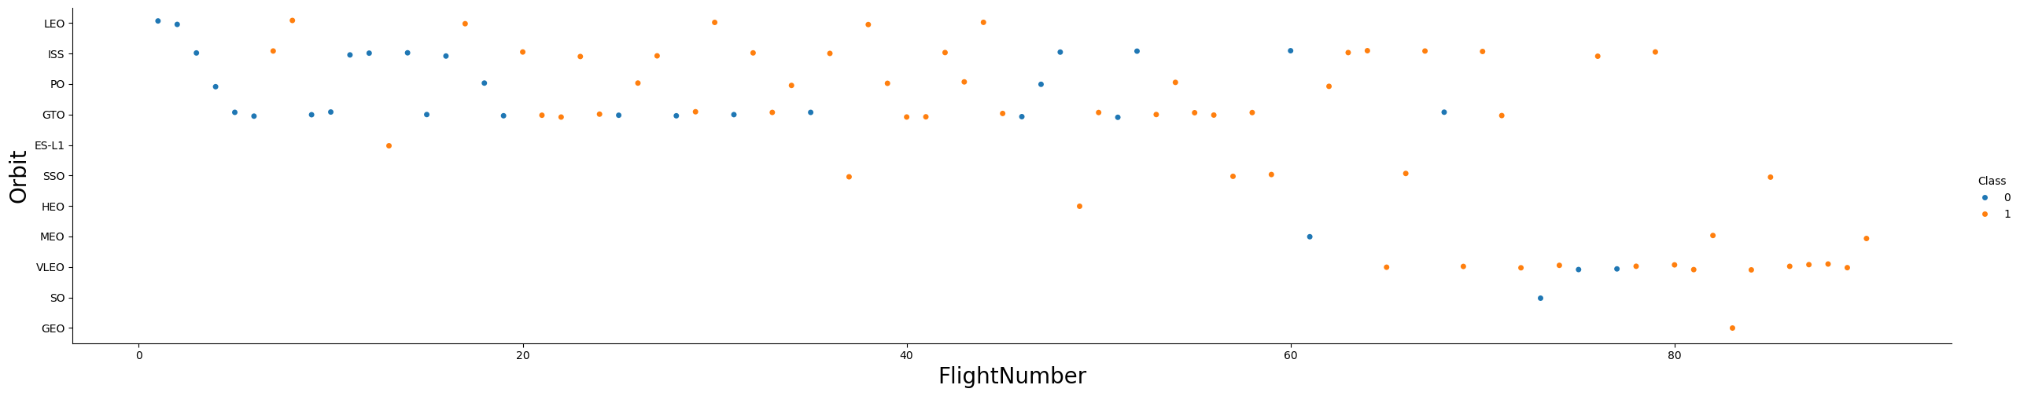
Flight Number vs. Orbit Type
As observed in the previous bar chart, ES-L1, GEO, HEO, and SSO has 100% success rate. Here, we can see these orbits have only one flight except SSO which has 5 flights.
Other than this, there is little relationship between successful flights and orbits

Slide 23
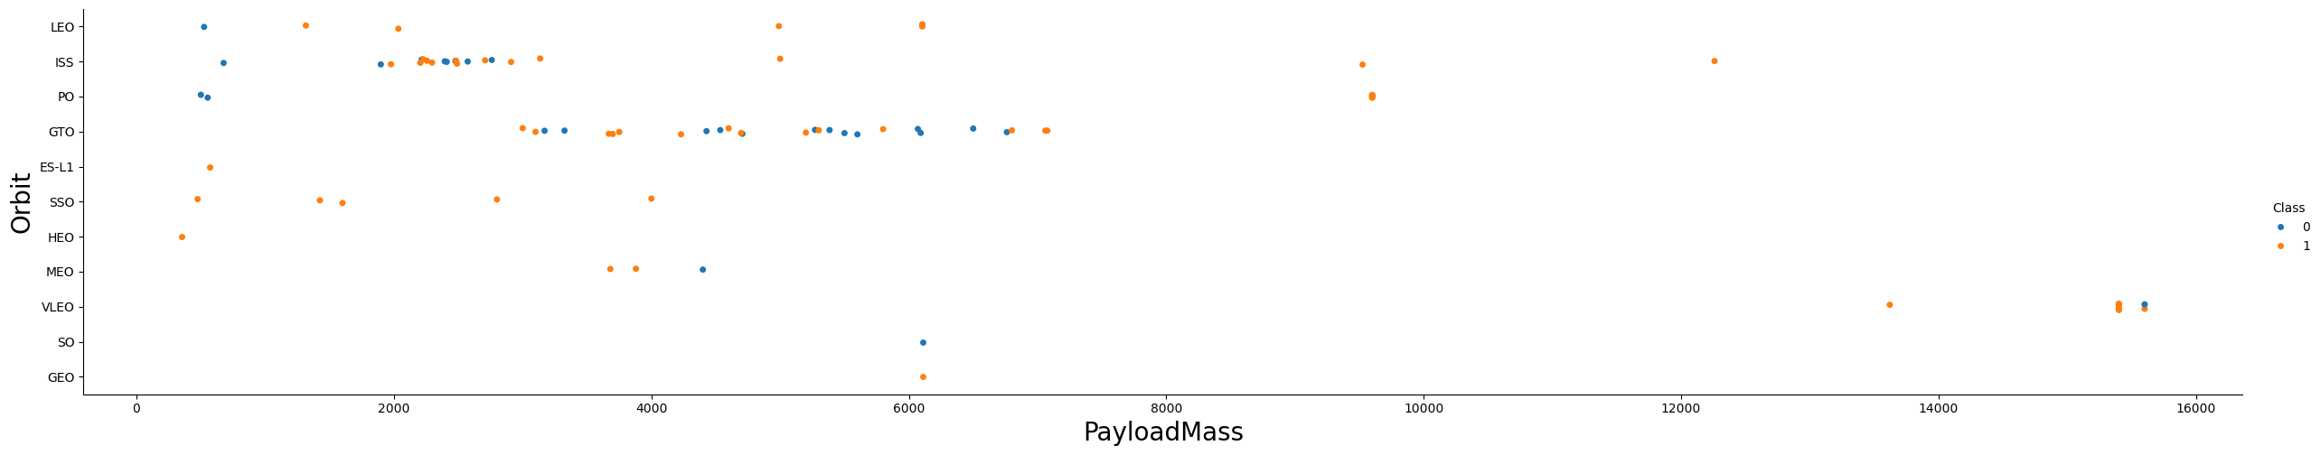
Payload vs. Orbit Type
Success rate of the launch is higher for higher payloads irrespective of orbit
Some orbits have high rate of success for lower payload mass
ES-L1, SSO, HEO, LEO

Slide 24
Launch Success Yearly Trend
Success rate has been constantly increasing since 2013 until 2017
Year 2018 saw a dip in success rate and it has been recovered in subsequent years
It is good idea to further analyze the external factors involved in low success rate in the year 2018

Slide 25
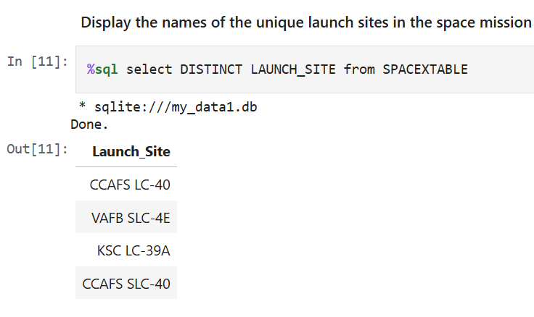
All Launch Site Names
Below screenshot shows the list of all launch sites
CCAFS LC-40 and CCAFS SLC-40 could be the same sites and need some additional information to validate this assumption and accurately represent all metrics

Slide 26
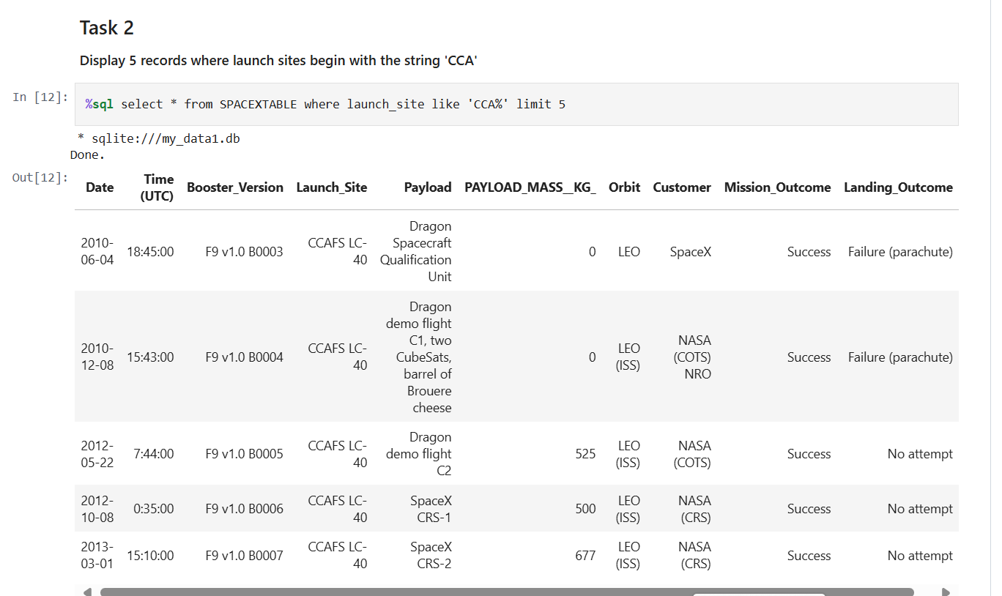
Launch Site Names Begin with 'CCA'
‘like’ and ‘limit 5’ helps in retrieving 5 records where launch sites begin with the string ‘CCA’

Slide 27
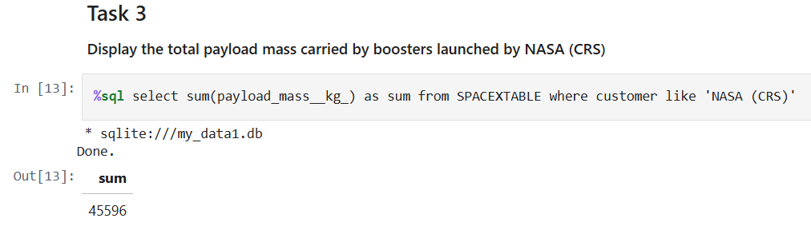
Total Payload Mass
Total payload carried by boosters from NASA is 45,596 kgs
‘SUM’ is the keyword used here to calculate total payload

Slide 28
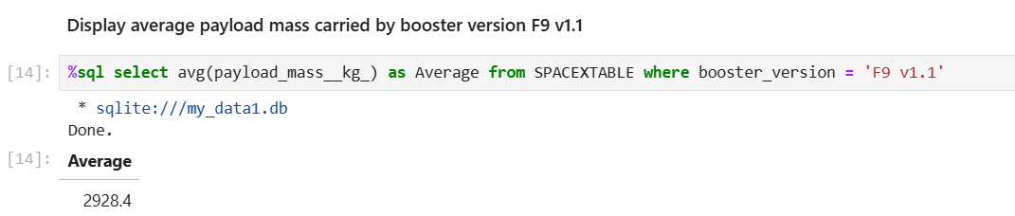
Average Payload Mass by F9 v1.1
On an average 2,928 kg payload mass carried by booster version F9 v1.1
‘avg’ is used to calculate the average payload; ‘like’ or ‘=‘ can be used to specify the condition based on the specific requirements

Slide 29
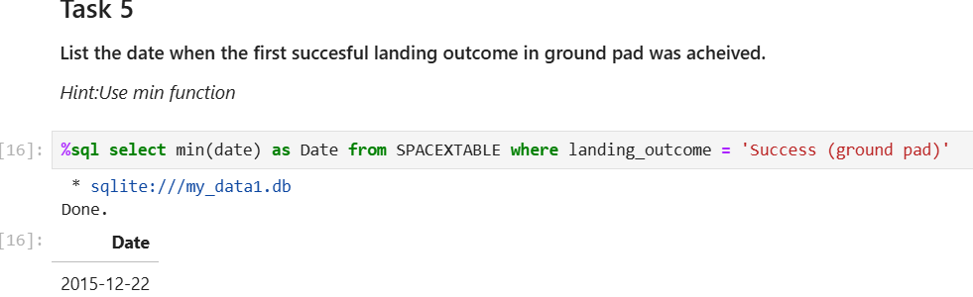
First Successful Ground Landing Date
The first successful landing outcome on ground pad happened on December 22, 2015
‘min’ is used to find the earliest date of success

Slide 30
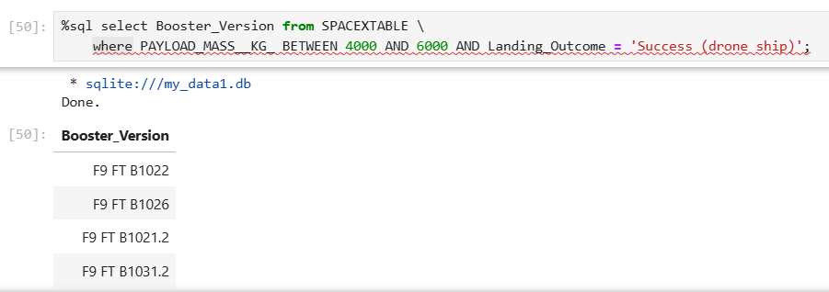
Successful Drone Ship Landing with Payload between 4000 and 6000
List the names of boosters which have successfully landed on drone ship and had payload mass greater than 4000 but less than 6000 is determined using ‘between’ and ‘and’ conditions
There are total 4 of them

Slide 31
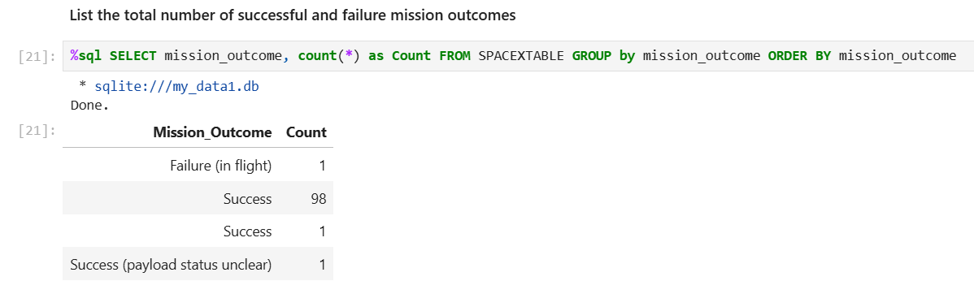
Total Number of Successful and Failure Mission Outcomes
As per the results below, more than 99% of the mission outcomes are success
Out of 101 mission outcomes, only 1 is a failure. This shows the immense planning and tight execution of missions
I have two rows of mission outcome as “Success”. This may be due to space at the beginning or ending.
This can be avoided by further data cleansing.

Slide 32
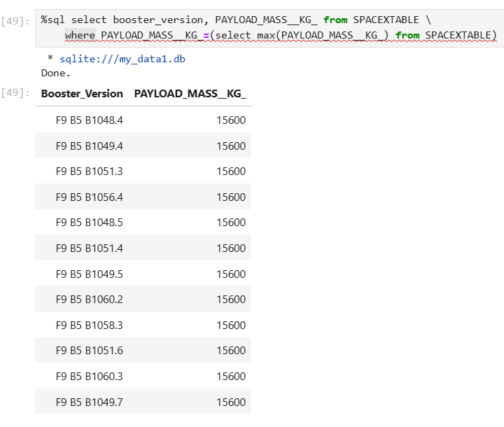
Boosters Carried Maximum Payload
This query used ‘max’ function to get the list of booster versions that carried maximum payload
‘F9 B5 B10XX.X’ are the versions carried maximum payloads
Further analysis needed:
Are there any ‘F9 B5 B10XX.X’ boosters which doesn’t carry maximum payloads?
What are the technical limitations or other reasons for any other versions not carrying maximum?

Slide 33
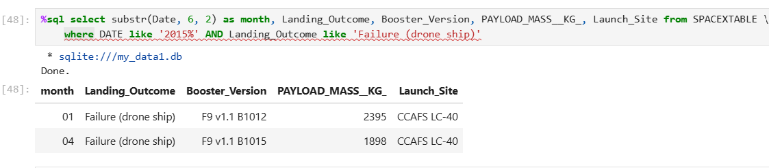
2015 Launch Records
There are two failures in 2015 in drone ship. These two happened in the months of January and April
Payloads on these both failed missions are on lower side

Slide 34
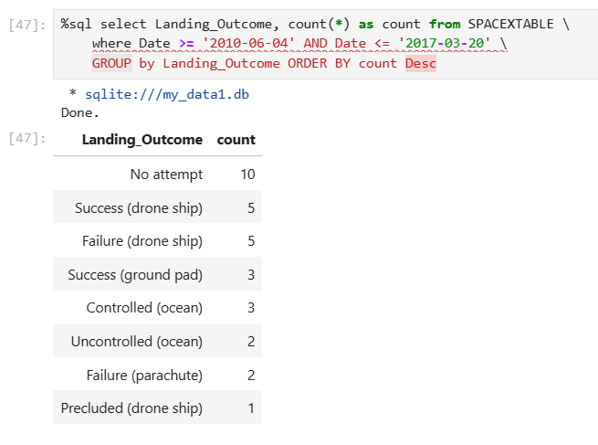
Rank Landing Outcomes Between 2010-06-04 and 2017-03-20
Between the date 2010-06-04 and 2017-03-20, highest category of the landing outcome is labelled as “No Attempt”. This need to be further investigated
‘where’ clause is used along with ‘>=, <=‘ operators to get the desired outcome

Slide 35

Section 3

Slide 36
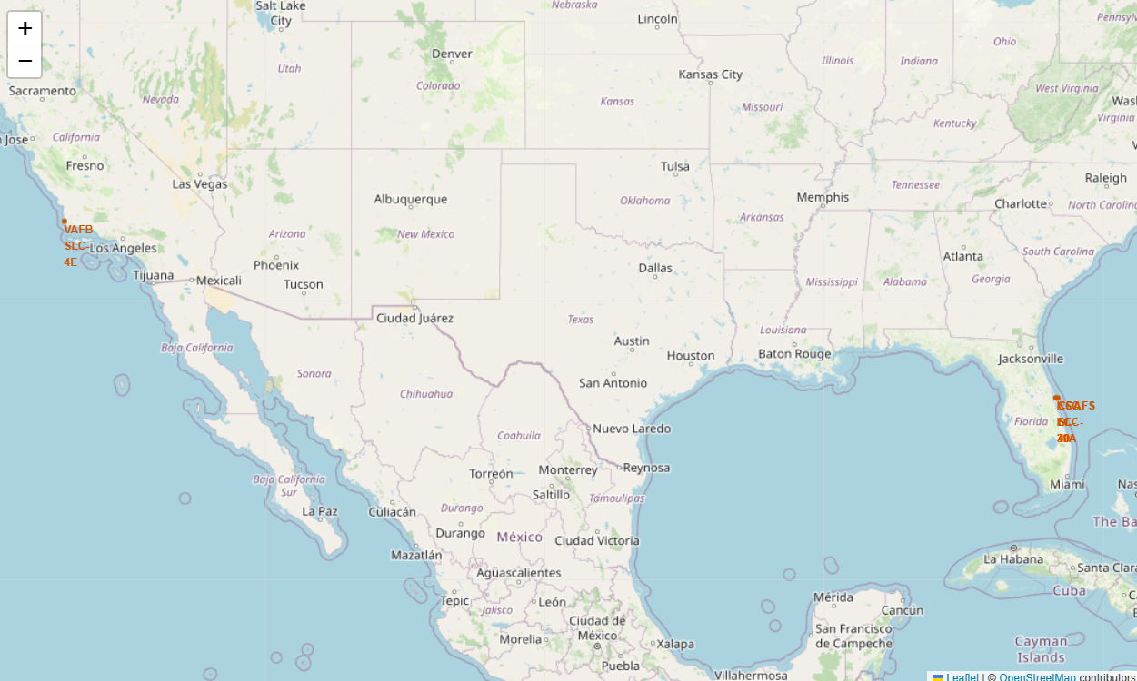
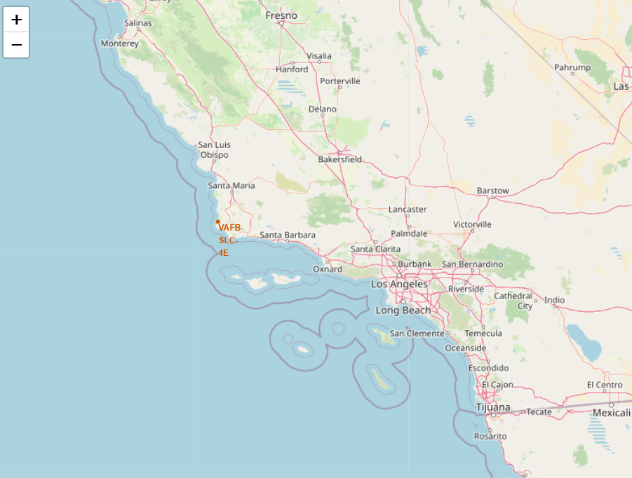
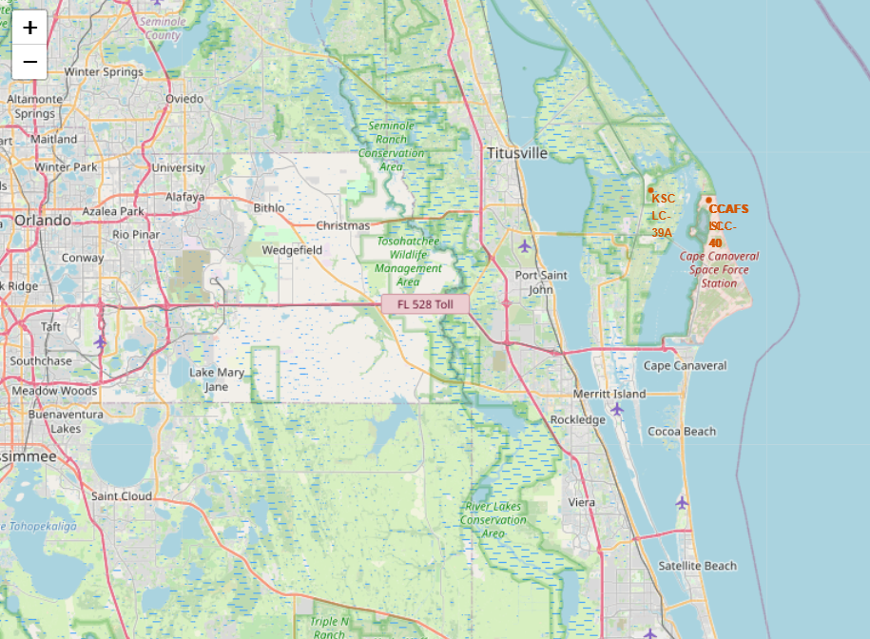
Launch Sites Folium Map
These folium maps showcase the launch sites. Zoomed-in versions are provided for California and Florida launch sites.

Slide 37
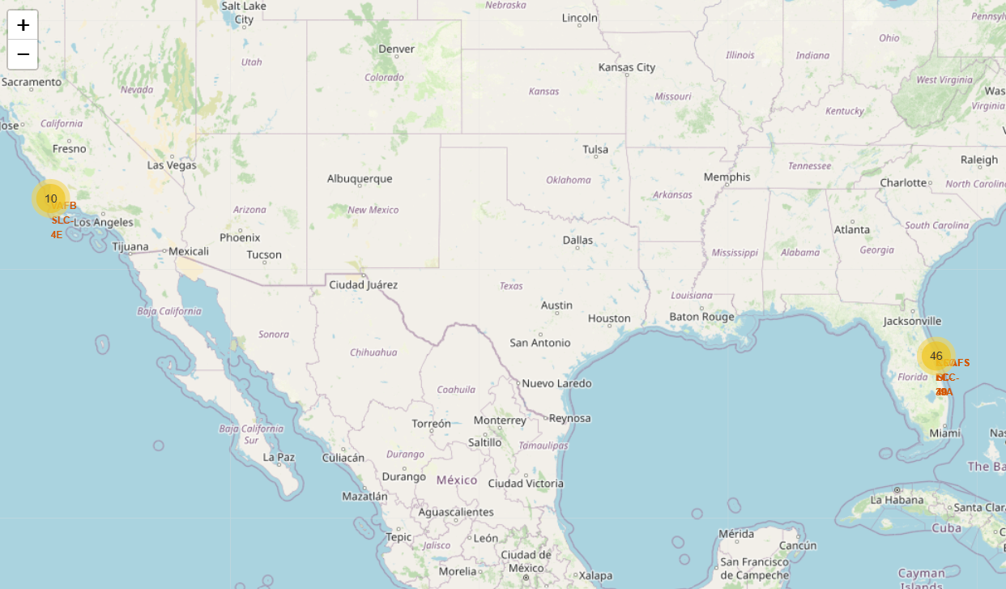
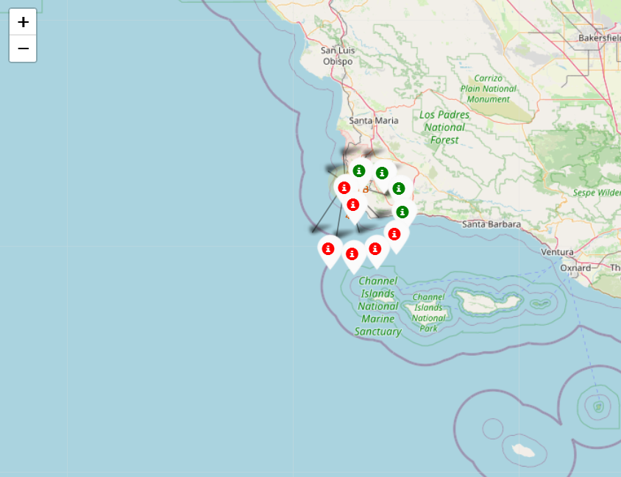
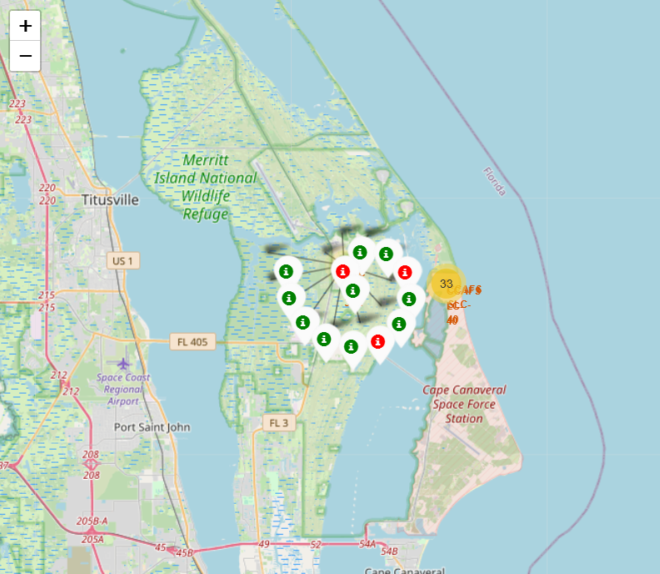
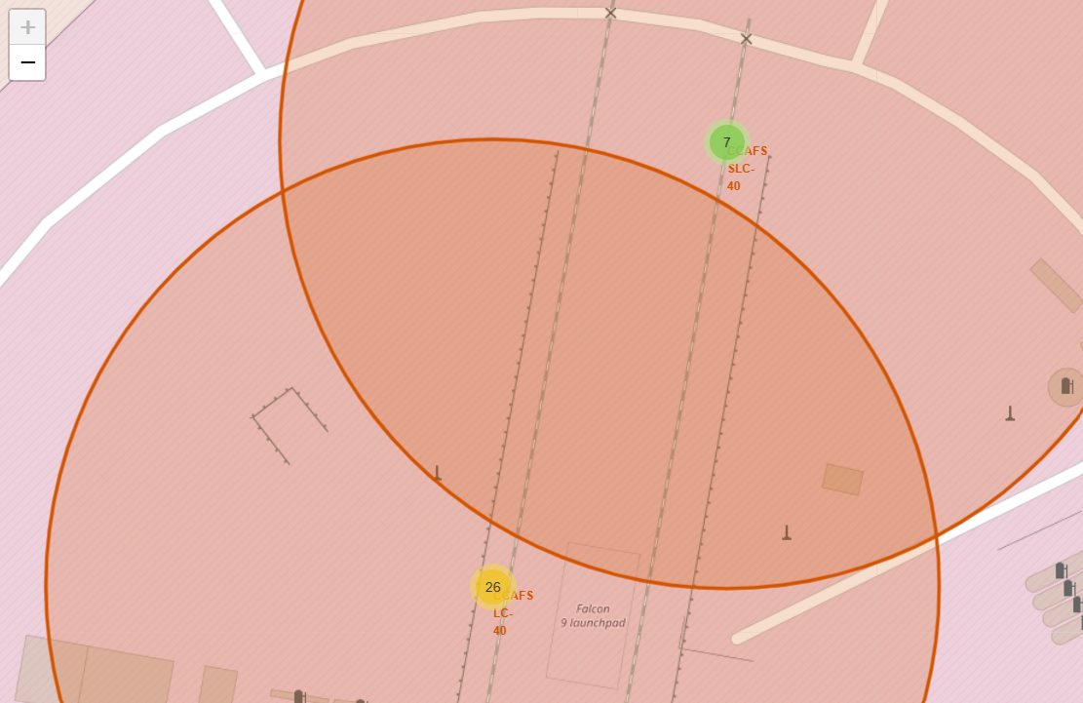
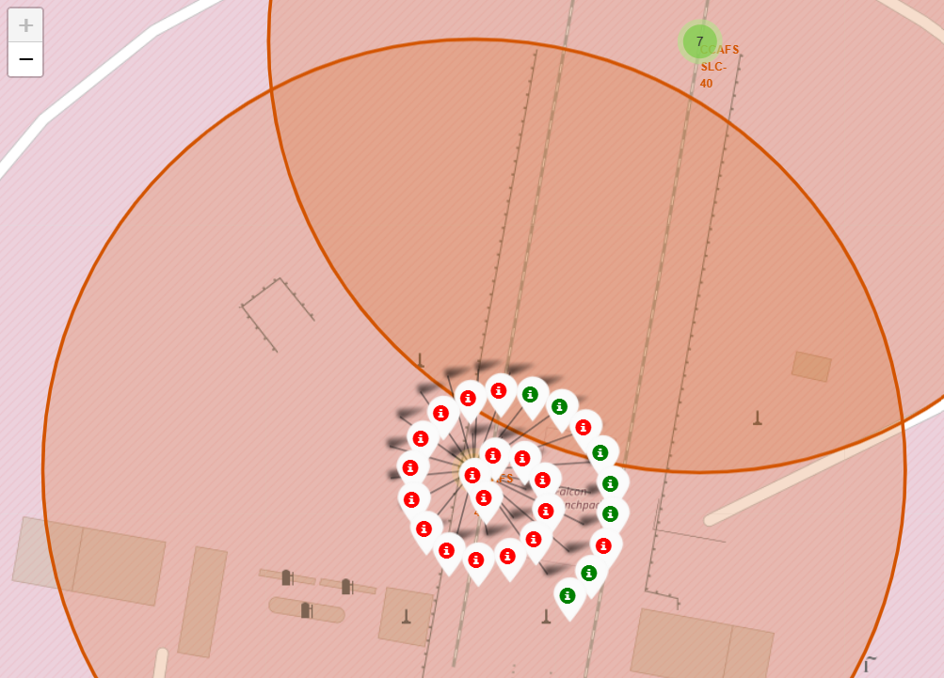
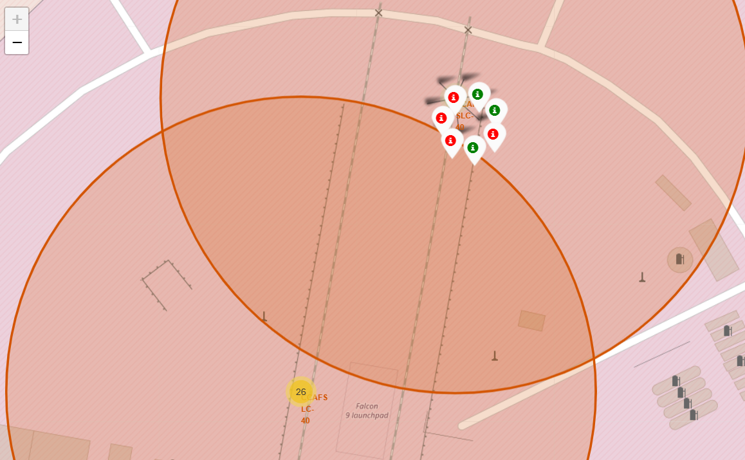
Success and Failed Launches for Each Site
VAFB SLC – 4E
KSC LC – 39A
CCAFS SLC – 40 and CCAFS LC – 40
Legend
Green – Success
Red – Failure

Slide 38
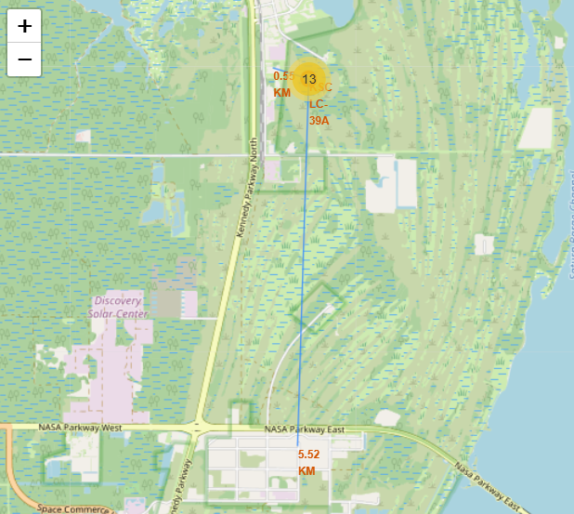
Proximity Map of the Launch Sites
Given sample (KSC LC-39A) shows that the launch sites are near to the railways, highways, and coasts for convenience in terms of supply chain and transportation activities

Slide 39

Section 4

Slide 40
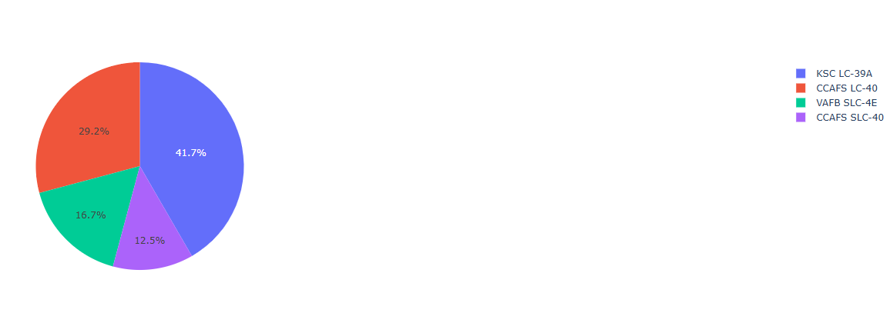
Total Success Launches by Site
Out of all KSC LC – 39A has highest percentage of successful launches
Based on map, CCAFS LC – 40 and CCAFS SLC – 40 seems to be the same site
So, this site contributed same amount of successful launches as KSC LC – 39A site

Slide 41
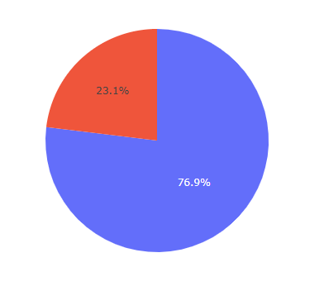
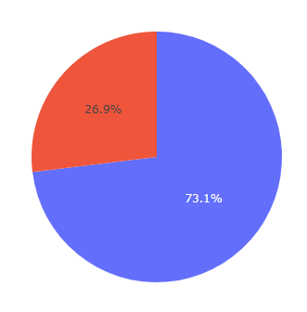
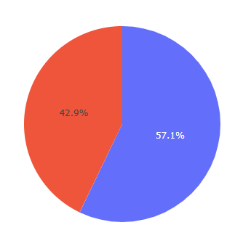
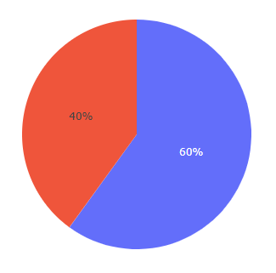
Success Rate by Launch Site
KSC LC – 39A site has almost 77% of success rate out of total launches.
CCAFS SLC – 40 site has lowest success rate of all site at 57.1%
KSC LC – 39A
CCAFS LC – 40
CCAFS SLC – 40
VAFB SLC – 4E

Slide 42
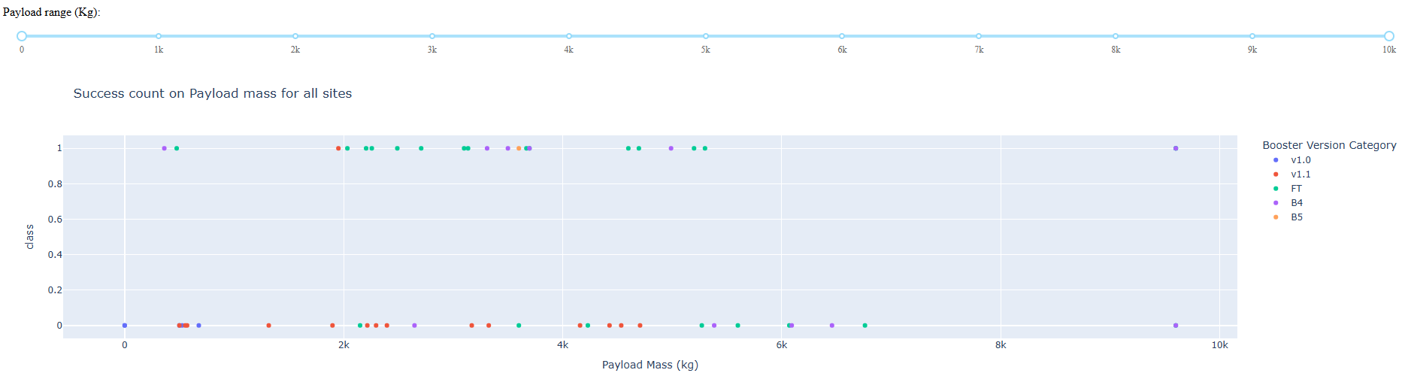
Launch Outcome Vs. PayLoad for All Sites
Booster Version Category v1.1 has lot of unsuccessful launches comparatively
This can be further analyzed by dividing it into small (0 to 5K kg) vs big payloads (5K to 10K kg)

Slide 43
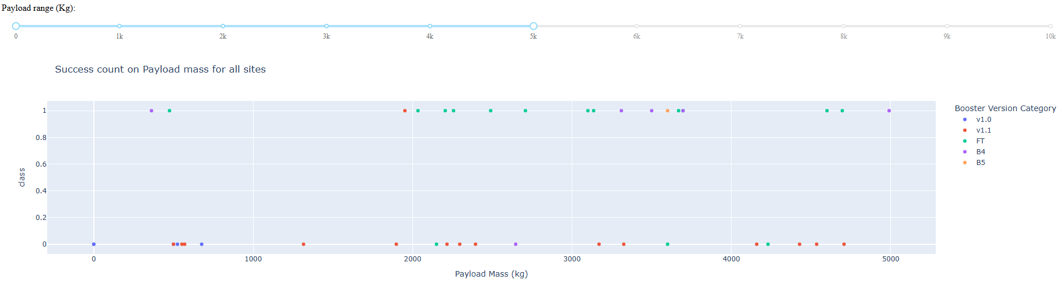
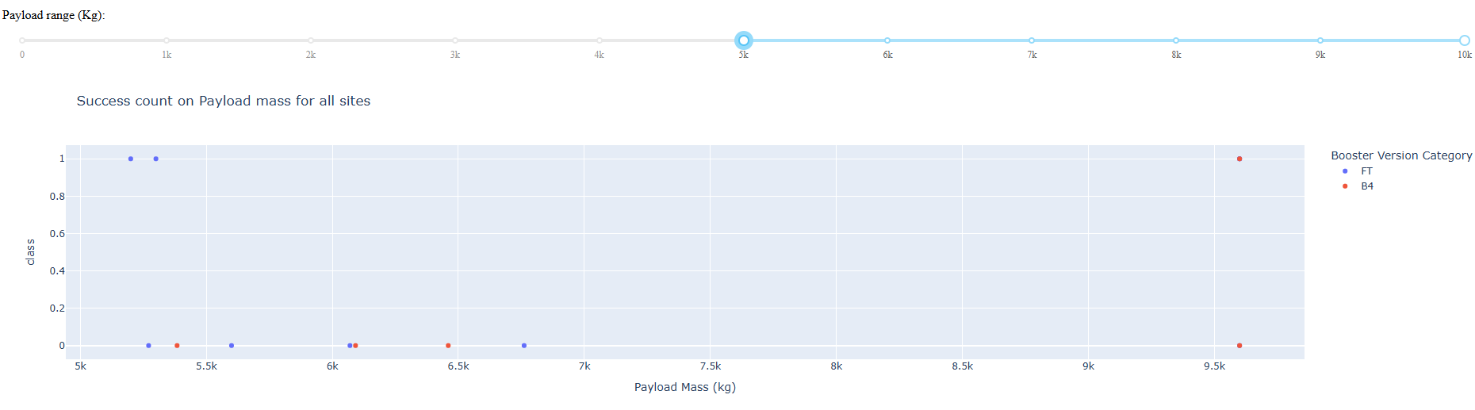
Launch Outcome Vs. PayLoad for All Sites – Contd
Bigger payloads have less success rate compared to smaller payloads
v1.0 and v1.1 booster version categories are specifically carrying smaller payloads and their success rate is much lower

Slide 44

Section 5

Slide 45
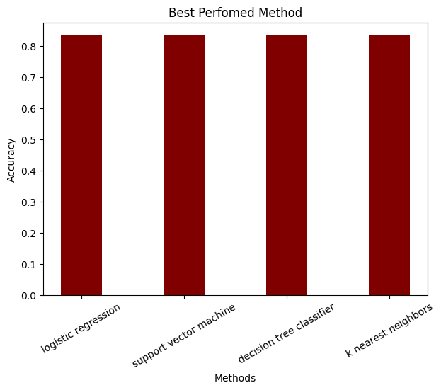
Classification Accuracy
Based on the accuracy scores all the methods are providing same amount of accuracy
However, decision tree classifier score is slightly higher than other methods.
Small test sample size could be the reason for this same accuracy levels and this analysis could be done with bigger testing sample size

Slide 46

Confusion Matrix
Confusion matrix shows 3 of the occurrences which are actually not landed are labeled as landed (false positives)
The model did not show any false negative error
Increasing test sample size might give us different set of results and this is necessary to identify best performing model.

Slide 47
Conclusions
ES-L1, GEO, HEO, and SSO orbits have 100% success rate
While SO orbit type has the least success rate i.e., 0%
Year 2018 saw a sudden dip in successful launches compared to constant increase of successful launches from 2013 to 2017
Launch sites are located near by railway stations, airports, and coasts for easy logistics access
KSC LC – 39A is the site with highest success % around 77%
All the predictive models are giving similar accuracy % - This can further be validated by changing the test and train sample sizes

Slide 48
Appendix
All the jupyter lab files, and python files have been uploaded to GitHub repository. Use the below link to access those files
VisaliNerla_DataScienceCapstone_Lab_Files

Slide 49


